Slide 1
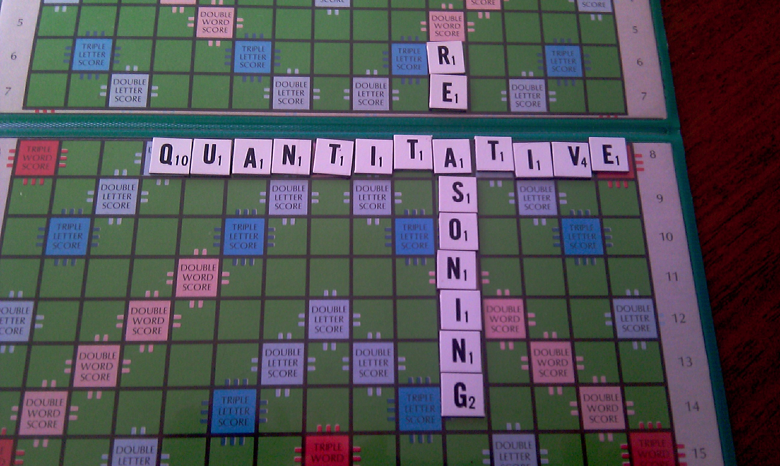
Notes:
Welcome to Quantitative Reasoning!
<number>

Slide 2
Dave Smith QR Section 5 & 12
Email: dave.smith@yale-nus.edu.sg
Office: Zoom link on Canvas
Office Hours:
TBA (see Canvas announcement)
Notes:
Change this for your classes.
<number>

Slide 3
INTRODUCING QR
What we teach in QR
Why we teach QR
How we teach QR
Notes:
<number>

Slide 4
WHAT? (See Canvas for more details)
Data Literacy
Data exploration and visualisation
Relationships between variables
Experiments and Sampling
Simulation and randomness
Computer Programming in R
Notes:
The items under “Data Literacy” are essentially the textbook topics that we will cover
The 2nd and 3rd bullet points are
<number>

Slide 5
WHY?
“There are three kinds of lies: lies, damned lies, and statistics.”
-Attributed to Benjamin Disraeli by Mark Twain

Slide 6
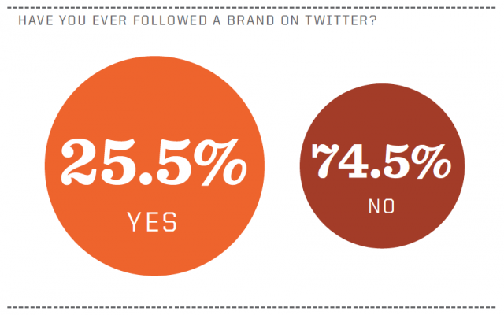
Bad reasoning, visualizations, and analyses mislead.
http://www.marketingtechblog.com/bad-infographics/

Slide 7
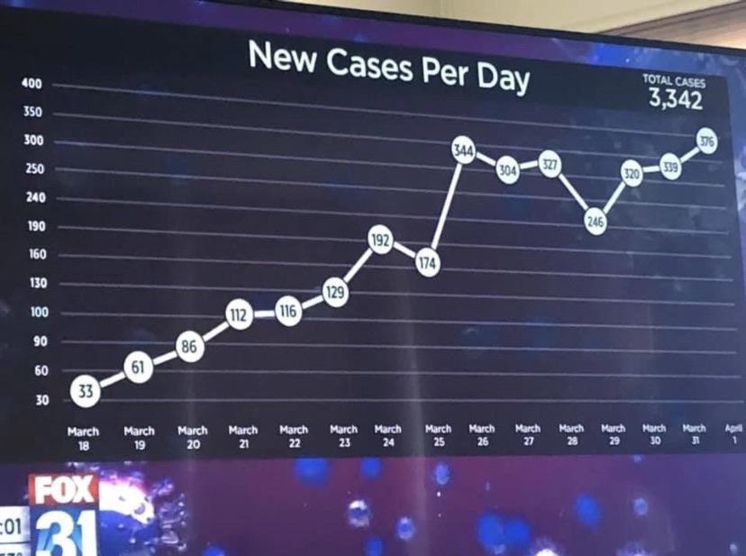
Data representation counts

Slide 8
Is data objective?
Suppose you encounter the following headline:
“Survey: 57% oppose welfare.”
Do you believe that you should be taxed so that other citizens don’t have to work?
Do you think the government should help those people who cannot find work?

Slide 9
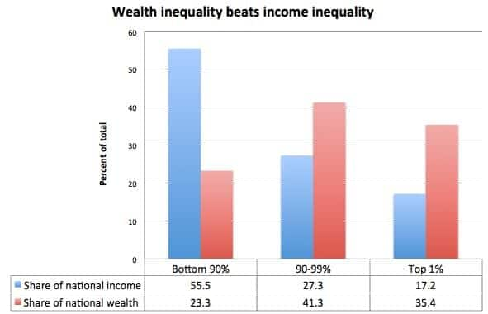
Is data objective?
How do we choose what to measure?
www.washingtonpost.com

Slide 10
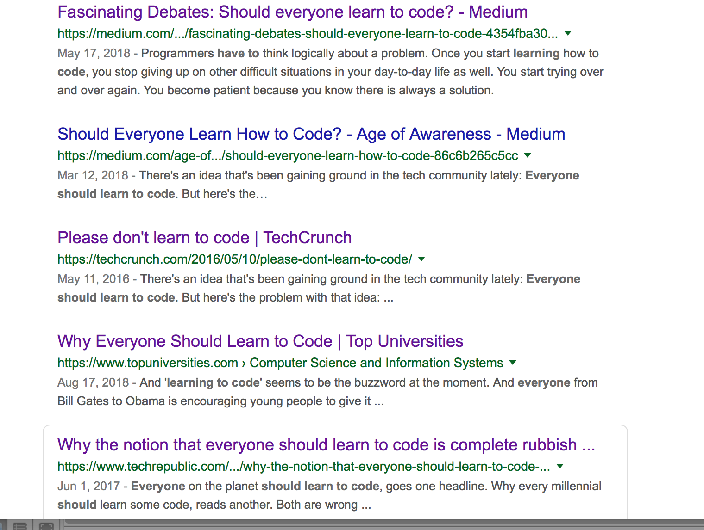
Should everyone learn to code?

Slide 11
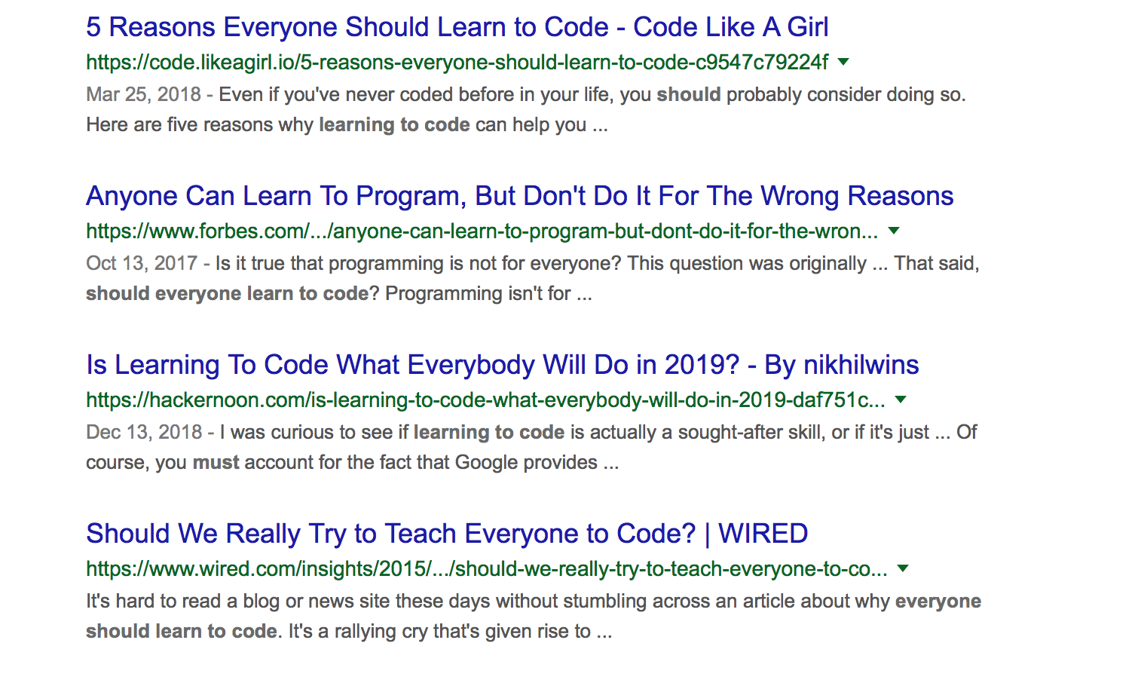
Coding
Should everyone learn to code?

Slide 12
Should everyone learn to code?
Opinion is mixed…
If you already know something about coding, you will get some practice
If you don’t, you’ll get a gentle introduction
Coding can be used to automate boring tasks and make you more productive / rested

Slide 13
HOW?
QR does not follow a traditional lecture format
The method we use requires the students to be more independent than lecture
Take advantage of the ungraded semester to build new academic habits that will help you throughout your time as a student

Slide 14
Evidence
http://www.montana.edu/msse/Data_analysis/Hake_1998_Normalized_gain.pdf
https://www.pnas.org/content/111/23/8410
https://www.sciencedirect.com/science/article/pii/S2452301115000115#bib4
https://info.maths.ed.ac.uk/assets/files/LandT/Deslauriers_Science_May2011.pdf

Slide 15
TBL: a specific type of “flipped classroom” or blended learning
Before class
In class:
Closed book
In class: Open
After class
1. Learn with prep work on your own
3. Solo quiz
IRAT
4. Clarify
doubts
(explain by peers; just-in-time teaching)
6. Team applications
7. Mini-lecture
8. Review lesson.
9. Complete assignments from lesson.
2. Consult teammates, tutors, instructor

Slide 16
Before-class preparation
Visit “Assignments” in the Canvas course page
Readings
Videos
Worksheets
Sample RAT questions
Discuss with your teammates
Visit peer tutors
Consult instructor
Notes:
<number>

Slide 17
QR Peer Tutors
Drop-in Hours
Sun, Mon, Tue, Wed
Evenings 7pm - 9pm
Location K Chanrai (Elm)
Zoom link on Canvas
One-on-one
Visit
yalenus.mywconline.com
to schedule an appointment
YinXi Bijaya JJ Ayesha Claire Reneez Golam Ann Vasu Mustafa

Slide 18
Before class: Readings
Stats: Data and Models
Pearson Global Edition, 4/E, ebook
Authors R.D. De Veaux, P.F. Velleman, D.E. Bock
Publisher Pearson
ISBN 978-1-292-101-637
.
NOT the new 5th edition.
Notes:
<number>

Slide 19
Typical class
Making the most of class time: not repeating things you could have read on your own, finding what to focus on.
Part 1: Quizzes on pre-class material
(For fairness, no pre-discussion)
IRAT (~10 mins) typical score: 60-70%
Class discussion of troublesome questions
*RATs primarily have a diagnostic (and not assessment) function, and each IRAT is worth <1% of final grade
Notes:
<number>

Slide 20
Typical class
Making the most of class time: exploring further.
Part 2: Class activity (~1 hour)
Real-life applications
Discussing cautions or controversies
Hands-on exploration of datasets
Part 3: Mini lecture (~15 mins)
Review of current class
Preview of next class, what to look for in readings

Slide 21
Assessments
Individual Individual Readiness Assurance Tests (IRATs): 20% Midterm Exam (16 Sep Week 6 Thu): 20%
Final Exam (18 Nov Week 14 Thu): 25%
Quantitative Experience: 10%
QR in the Wild: 10%
Group Presentation: 15%

Slide 22
Policy on absences
If you are going to miss class for any reason, email your instructor and your Assistant Dean before the class commences.
If you have a fever or feel unwell, please notify your AD and do not come to class.
To be marked as present, you must be an active and engaged participant in the lesson.
Students who accrue at least 4 unexcused absences will be considered for remediation. Unexcused absences in excess of that may result in a failing grade.

Slide 23
Sample IRAT Just for fun – ungraded!
Go to “Quizzes” in Canvas
For RATs and Tests, a student observed to have another webpage open on their computer, or using their mobile phone, will score zero on that assessment

Slide 24
5-minute break

Slide 25
Activity: How big is a number?
Thickness of earth’s atmosphere: 60 miles
Notes:
<number>

Slide 26
Activity: How big is a number?
Thickness of earth’s atmosphere: 60 miles
Notes:
<number>

Slide 27
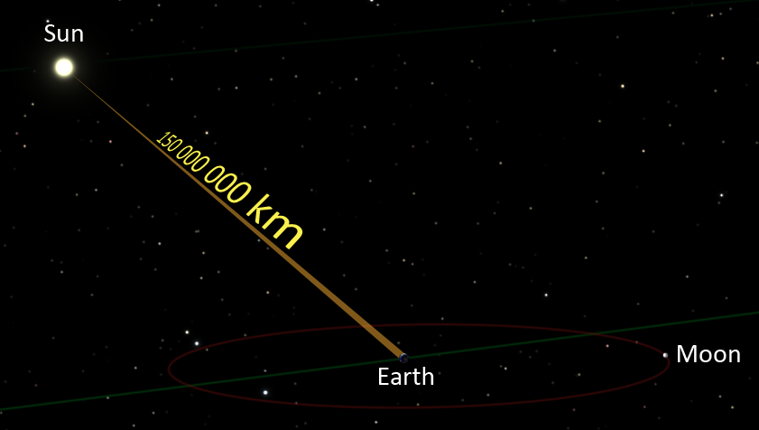
Activity: How big is a number?
Distance from earth to sun: 150,000,000 km
Notes:
<number>

Slide 28
Activity: How big is a number?
Distance from earth to sun: 150,000,000 km
Notes:
<number>

Slide 29
Activity: How big is a number?
Choose two of the following:
How many neurons are there in the brain?
What is the distance from Singapore to Moscow?
How small is an atom?
How big are the proven oil reserves in the world?
How old is the universe?
How much water is in the earth’s oceans?
Find out some numbers and express them in understandable ways.
Notes:
<number>

Slide 30
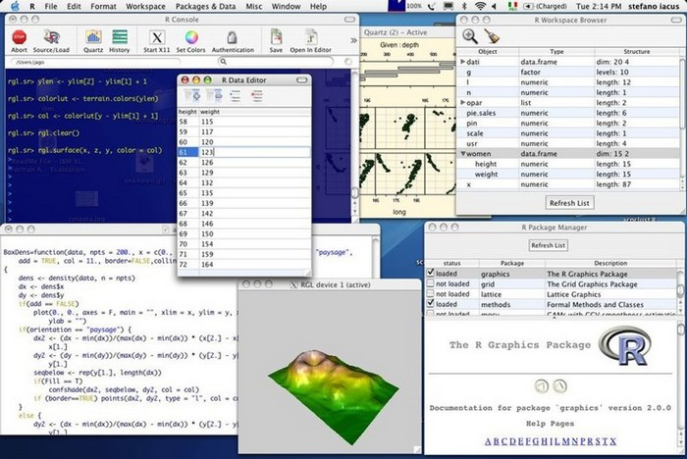
Practical Work: R
Notes:
<number>

Slide 31
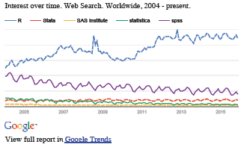
The Value of R
Popular
for statistical analysis and presentation in natural and social sciences
commonly used in start-ups for data analytics
Powerful
Flexible
Well-supported
Free
Notes:
<number>

Slide 32
The Value of R
Prof Jay Emerson (Yale):
A reasonably small set of “commands” or “manipulations” can accomplish a wide range of tasks in R, and most of these are very intuitive.
Don’t be deceived by the simplicity. R provides an elegant balance of simplicity, intuition and power that is unmatched.
R is particularly well-suited for engaging data at different levels of sophistication. But it’s also an extremely powerful and flexible programming environment.
Notes:
<number>

Slide 33
Import csv file to R
Download
https://qr.dasmithmaths.com/w1-thu/country_info.csv
And import into RStudio
Notes:
<number>

Slide 34
Help for Students
http://tryr.codeschool.com/
Peer tutors & drop-in centre (7-9pm Sun-Wed K Chanrai & Zoom)
R tutorial videos on Canvas
Notes:
<number>

