Slide 1
BIAS AND WHAT TO DO ABOUT IT
8 November, 2021

Slide 2
Learning Goals:
Understand how bias affects our interpretation of the world.
Understand the sources of bias and develop strategies for combating such bias.
Gain intuition about how likely random events are.

Slide 3
Activity 1: Milo

Slide 4
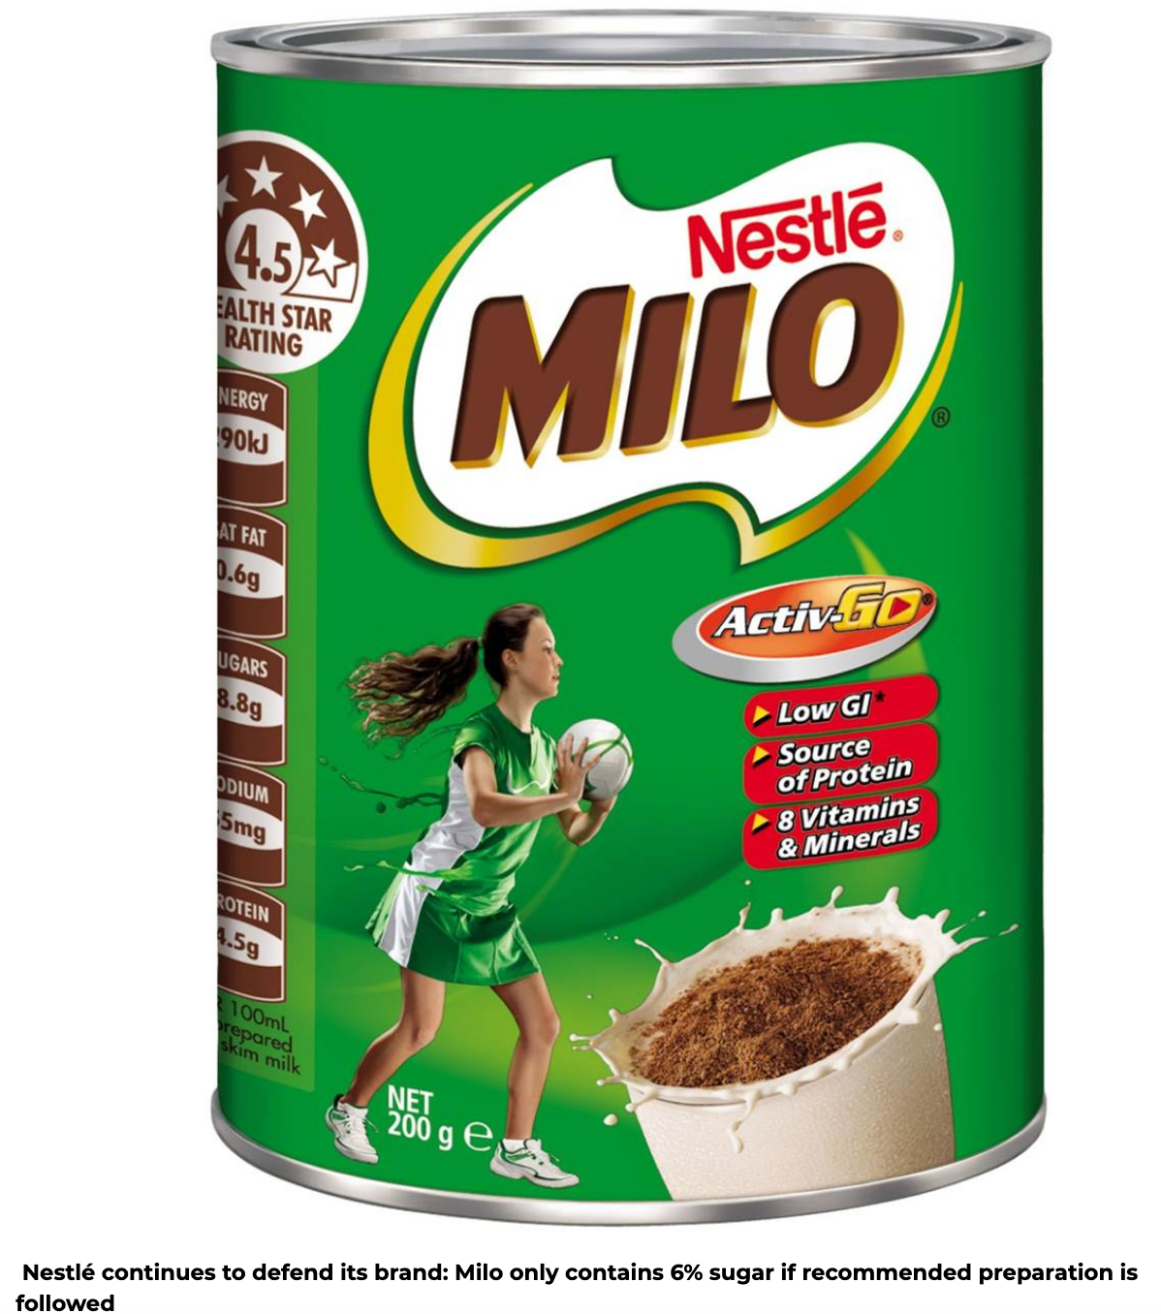
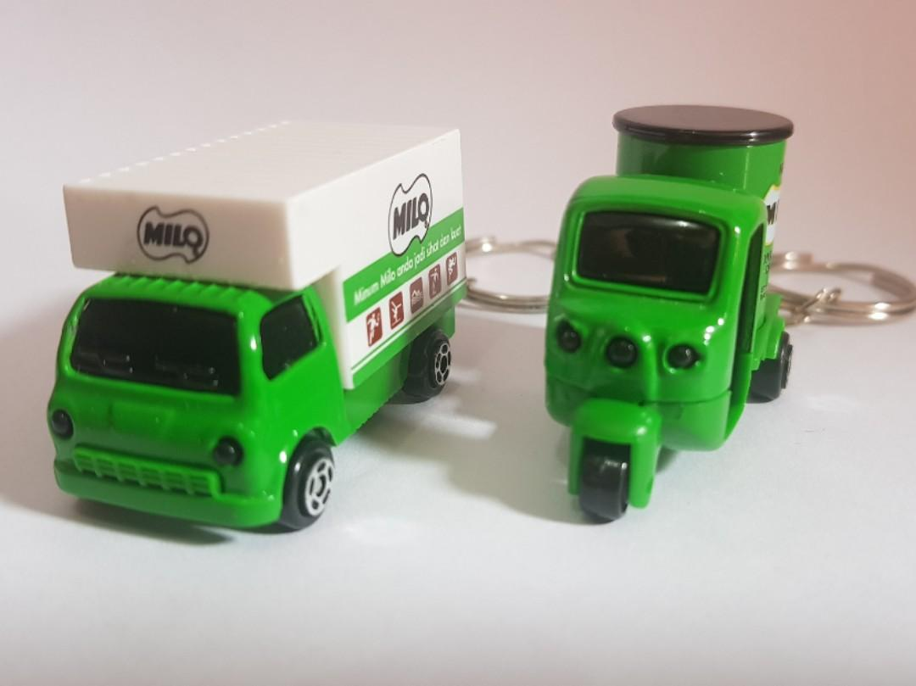
Some background
Milo is a beloved chocolate malt drink that is popular in SE Asia.
Nestlé promotes it as healthful, supporting physical activity and growth.
In 2018, Vishen Lakhiani posted a video claiming that a tin of Milo powder contains 40% sugar, much of which is added.
https://marketingmagazine.com.my/nestle-stands-its-ground-6-sugar-content-in-milo/ (first video: until 1:40)

Slide 5
Recall the facts
In its dry powder form, a serving of Milo weighs about 28 grams.
12 grams are from sugars; roughly 6 of them are from added sugars.
A standard serving involves mixing the 28 grams of powder into 200 mL of water.
A teaspoon of sugar contains ~4g of sugar.

Slide 6
What’s the message?
Consider these two statements:
Are they accurate?
Lakhiani – Milo powder contains 40% sugar by weight.
Nestlé – A serving of Milo (28g powder + 200 mL water) contains only 6% sugar by weight, and 54% of those sugars occur naturally in the primary ingredients.
Both claims are accurate.
Which claim do you think is more helpful?
How do you think each claim affects consumer behavior?

Slide 7
What’s the message?
Design a comparison to make the Milo sugar numbers more meaningful to yourself and others.
Hints: Recall what we did in Week 1
- What are other common types of sugar-heavy products?
How do you usually make your drinks, e.g. coffee?
Scientific benchmarks/recommendations for sugar consumption?
Is your example fair? Does it have an agenda behind it, hidden or not?

Slide 8
What’s the message? (potential answers)
200 mL of Coke contains 21 grams of sugar. Milo has 57% that amount.
One problem with thinking that 6% is low is that consumers might add sweetened condensed milk to it. According to Lakhiani, that can bring the sugar amount to 40g! That’s above the American Heart Association’s guidelines for daily added sugar for an adult male (9 teaspoons, 36 grams).

Slide 9
Activity 2: The face of a criminal?

Slide 10
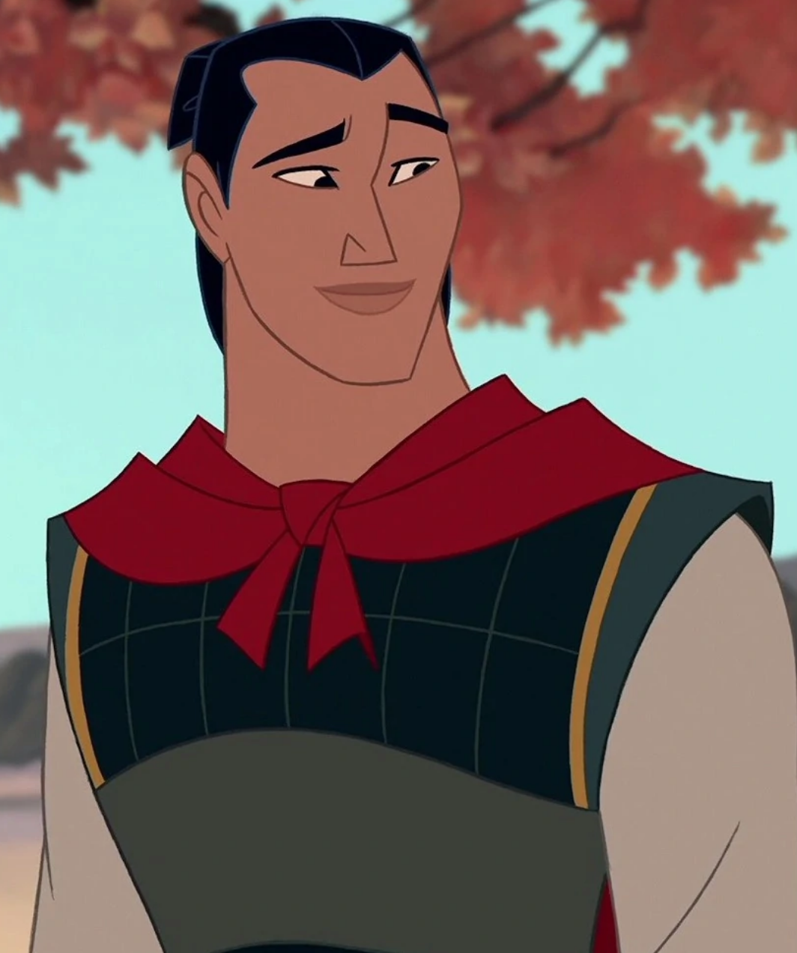
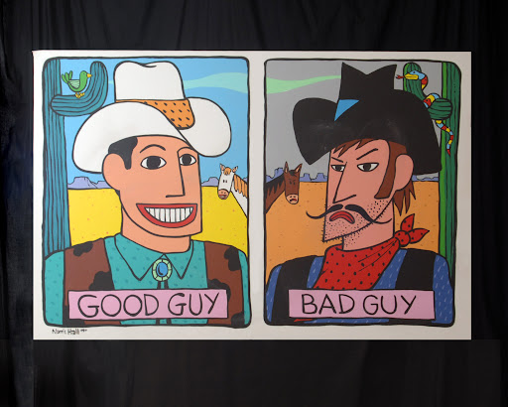
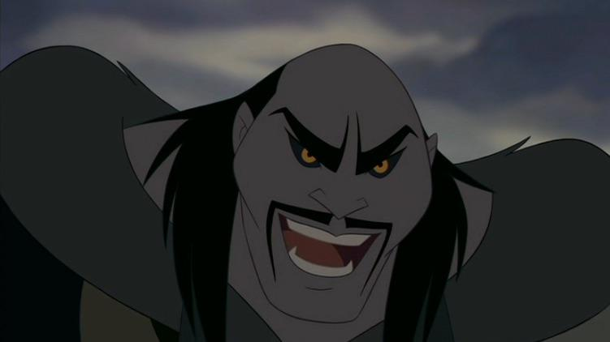
Some background
We all have assumptions about what “bad” and “good” characters should look like. These assumptions are both established and reflected in society (e.g. media).
Can you think of other non-Hollywood examples? How are good and bad guys usually depicted visually?
Notes:
Non hollywood examples

Slide 11
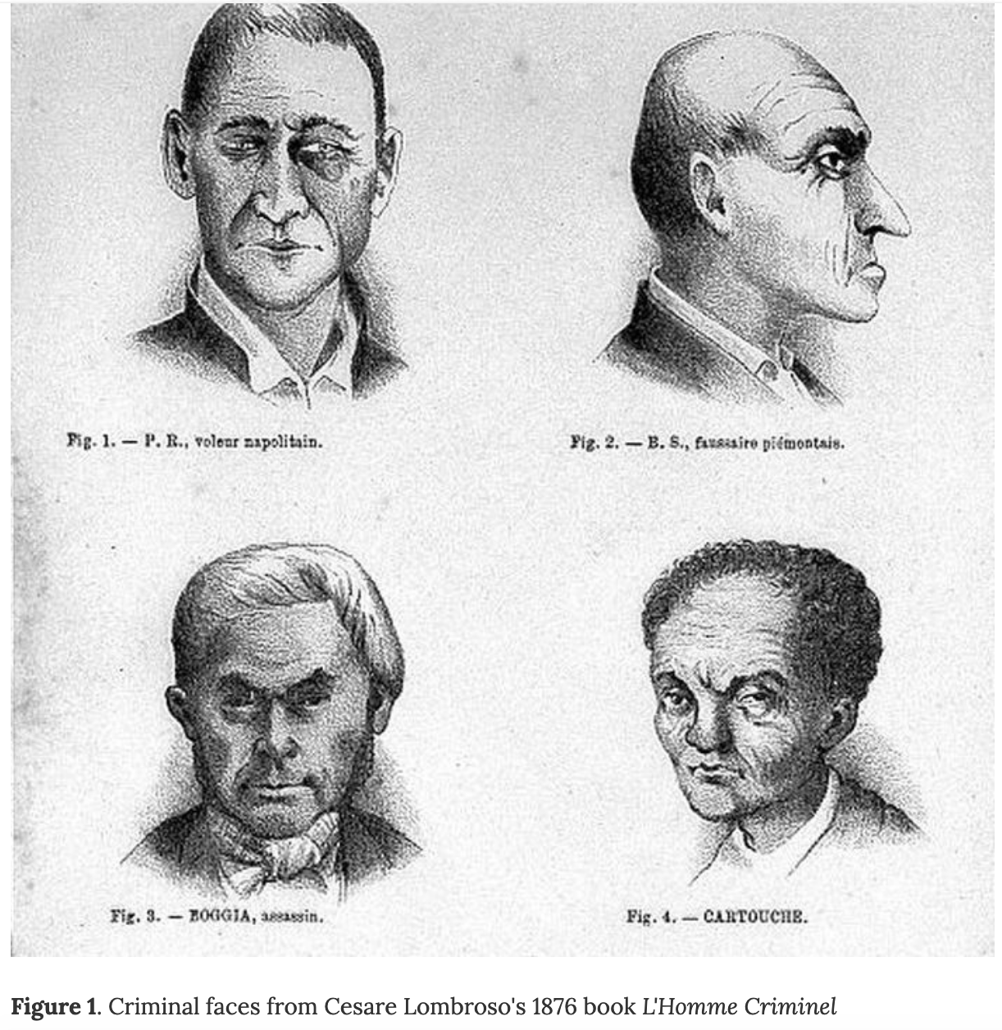
Some additional background
Across time and place, many people have believed that faces reflect tendencies or personality traits.
For example, Cesare Lombroso illustrated faces that show “criminality”.
In a recent study, Wu & Zhang (2016) claimed that machine learning could distinguish criminal and control faces at almost 90% accuracy.

Slide 12
The Paper
In their 2016 paper, Wu and Zhang revisit Lombroso’s program. Essentially, they aim to determine whether advanced machine learning approaches to image processing can reveal subtle cues and patterns that Lombroso and his followers could easily have missed.
To test this hypothesis, the authors deploy a variety of machine learning algorithms in a misguided physiognomic effort to determine what features of the human face are associated with “criminality”.

Slide 13
The Paper
They argue that their computer algorithms are free from the myriad biases and prejudices that cloud human judgment:
“Unlike a human examiner/judge, a computer vision algorithm or classifier has absolutely no subjective baggages [sic], having no emotions, no biases whatsoever due to past experience, race, religion, political doctrine, gender, age, etc., no mental fatigue, no preconditioning of a bad sleep or meal. The automated inference on criminality eliminates the variable of meta-accuracy (the competence of the human judge/examiner) all together.”

Slide 14
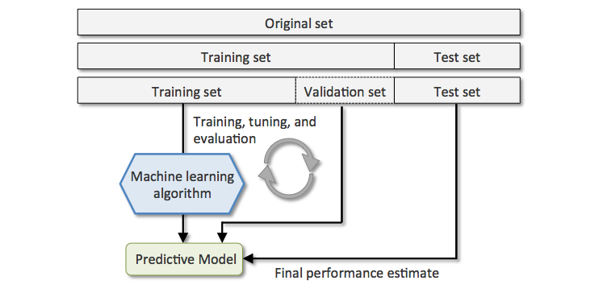
The Paper
The main finding: criminal and control faces can be distinguished with 90% accuracy.
Are you convinced? Can you identify any potential biases in their methodology?
The key to understanding the problems with the Wu and Zhang paper is to look at the training sets — the images used to teach the algorithm what a non-criminal face looks like and how criminal faces differ from non-criminal ones. A machine learning algorithm can be only as good, and only as unbiased, as the training data that we provide to it.

Slide 15
The Paper
The training data: 1,856 photos of Chinese men aged 18-55, with no distinguishing facial hair, scars, or tattoos.
1126 of these were photos of non-criminals scraped from a variety of online sources using a web spider; the authors know the occupation and educational background of each individual.
730 of the photos were pictures of convicted criminals, provided by police departments.
- 330 are published as wanted suspects
- The others are provided by a city police department in China under a confidentiality agreement
- The criminal face images are normal ID photos not police mugshots
- Out of the 730 criminals 235 committed violent crimes including murder, rape, assault, kidnap and robbery; the remaining 536 are convicted of non-violent crimes.”
Notes:
what did these authors provide to their algorithm as training data? They collected over 1,800 photos of Chinese men aged 18-55, with no distinguishing facial hair, scars, or tattoos.

Slide 16
Discussion: Potential problems?
What are potential issues with how the samples were obtained?
Control faces are from ID photos gathered from the internet.
Criminal faces are from IDs used by police departments.
Criminal faces are from convicted criminals.

Slide 17
The key problems: Biased sampling
What are potential issues with how the samples were obtained?
1. the images of non-criminals have been posted to websites presumably designed for promotional purposes, be they company websites or personal profiles. Many of these images will have been chosen by the photo subject himself; most of the others, while chosen by a third party, will presumably have been picked to convey a positive impression.
By contrast, the images from the set of criminals are described as ID photographs. These may have been selected neither by the individual depicted, nor with the aim of casting that individual in a favorable light.

Slide 18
The key problems: Biased sampling
What are potential issues with how the samples were obtained?
2. The authors are using photographs of convicted criminals. As a result, even if there is some signal here, the machine algorithm could just as easily be responding to the facial features that make someone likely to be convicted by a jury, rather than the facial features correlated with actually committing a crime.

Slide 19
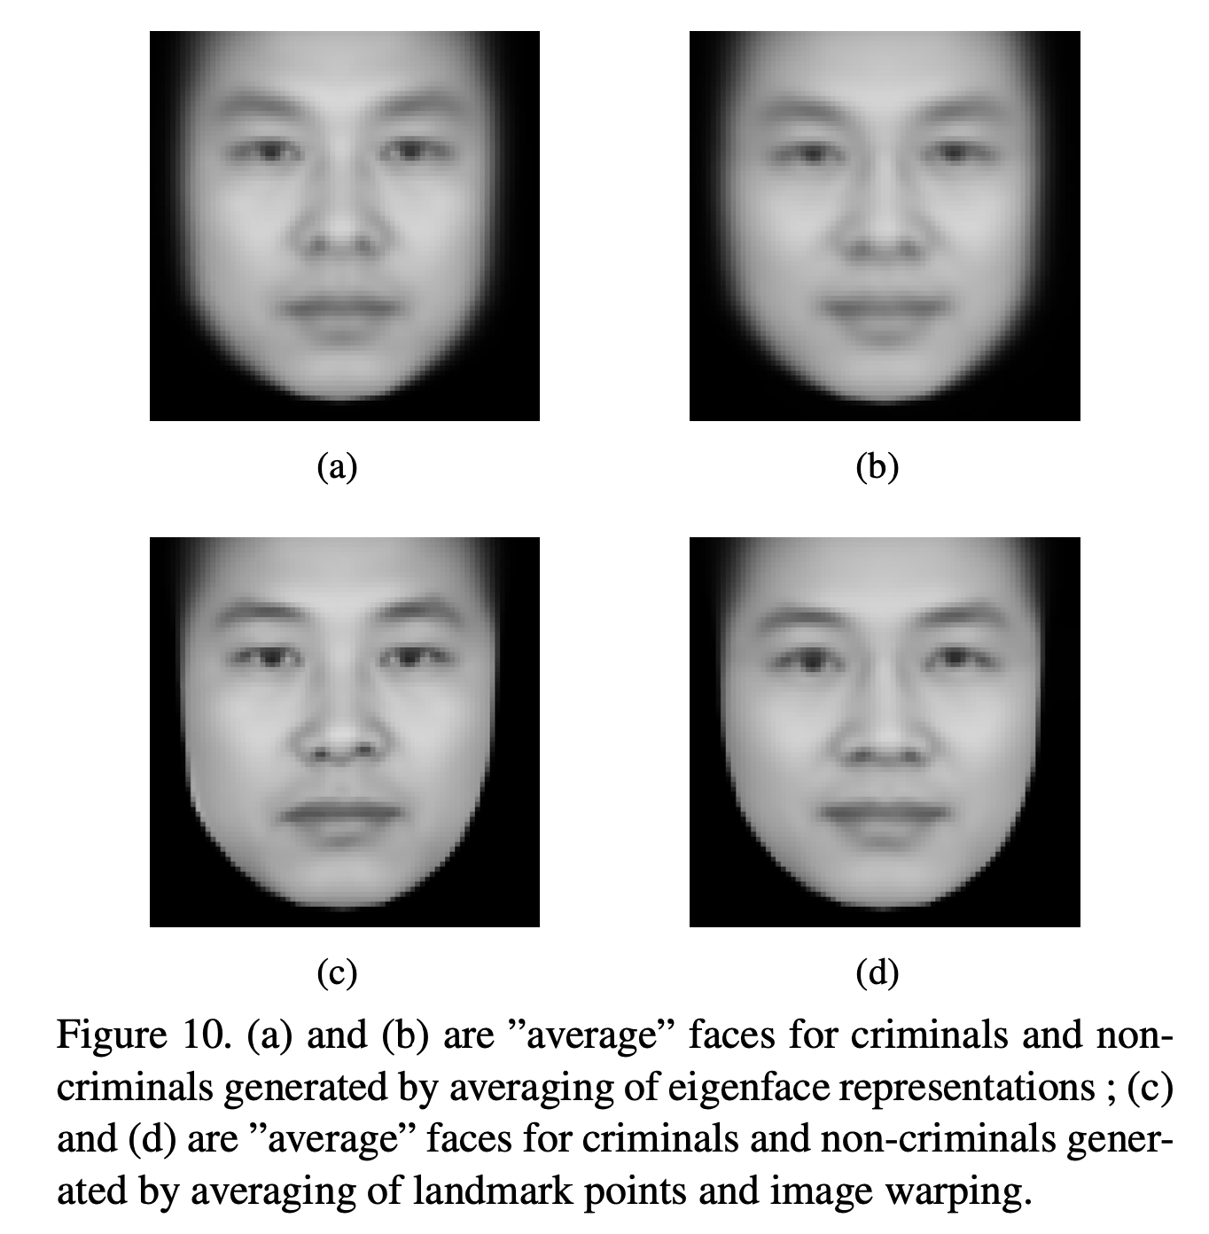
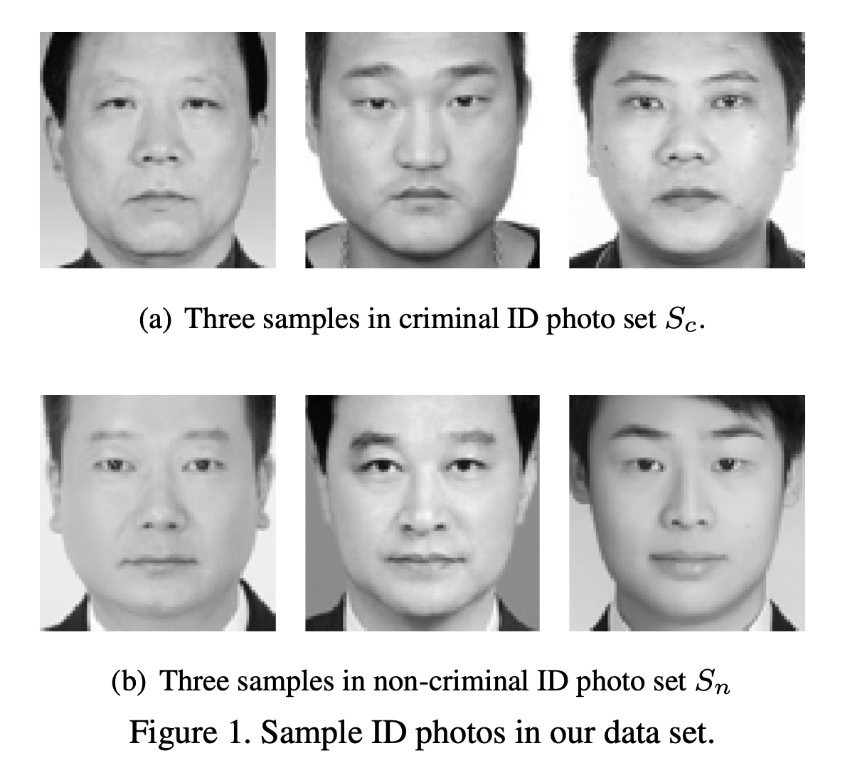
Discussion: how do the samples bias the algorithm?
Do the samples look the same? Might they differ because of the contexts in which the photos were taken or their intended use?

Slide 20
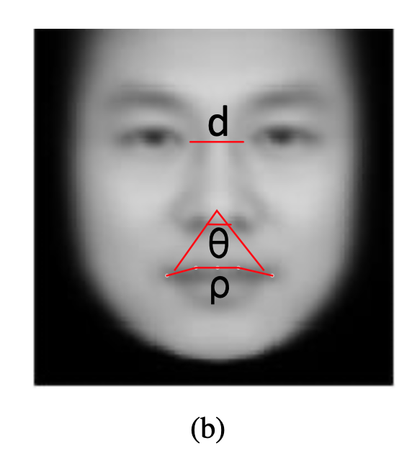
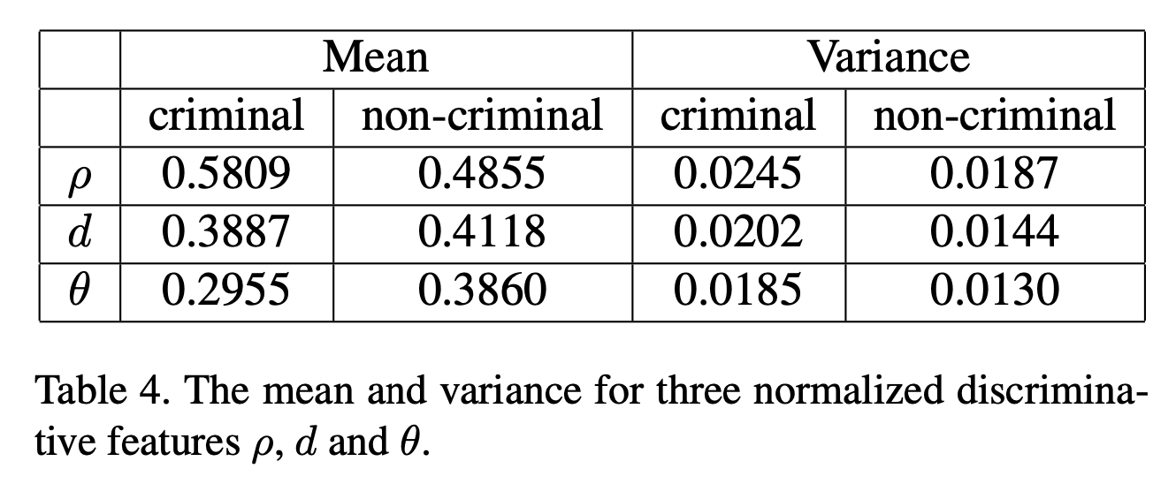
How algorithms can be biased:
The algorithms primarily differentiate groups based on mouth features.
The algorithm finds that criminals have shorter distances d between the inner corners of the eyes, smaller angles θ between the nose and the corners of the mouth, and higher curvature ρ to the upper lip.

Slide 21
How algorithms can be biased:
Why would this possibly be?
One obvious explanation for the nose-mouth angle θ and the lip curvature ρ:
As one smiles, the corners of the mouth spread out and the upper lip straightens.
Try it yourself in the mirror.

Slide 22
How algorithms can be biased:
All of the criminals are frowning or scowling, while the non-criminals are faintly smiling.
The authors have confused facial features with facial expressions.

Slide 23
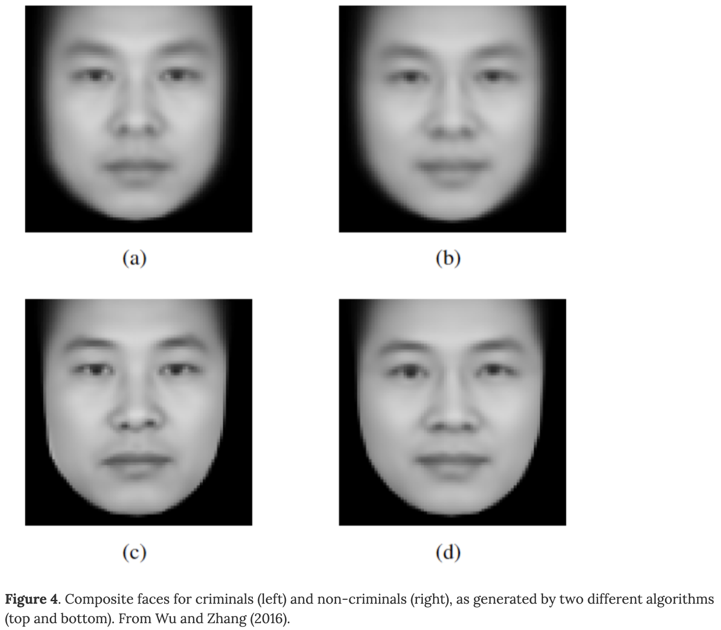
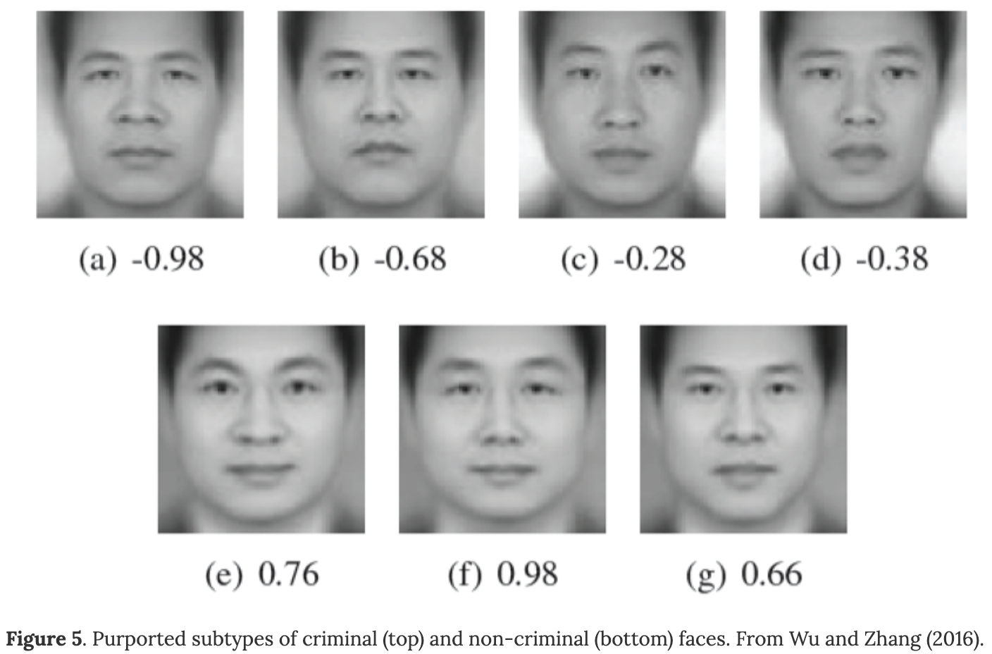
(Re)evaluating our claims

Slide 24
Conclusion
The algorithms primarily differentiate groups based on mouth features.
These features may differ across the groups because of different micro-expressions (e.g. slight smiles, facial tension, etc.) across them. Micro-expression is a confound.

Slide 25
What is learned
Algorithms can be unbiased in important ways.
But they are built by people. What is fed to the algorithm is selected by people. What the algorithm produces is interpreted by people.
A machine learning algorithm is only as good as its training data, and we can see that the training set used here is fundamentally flawed for the purpose it is used.
You can (and should) critique such findings even if you do not understand the machine learning algorithms themselves.
Notes:
Put photos in a separate folder

